Slide 1
What is AI?

Slide 2
Artificial Intelligence (AI) is a branch of computer science focused on creating systems and algorithms that enable machines to perform tasks that would typically require human intelligence.

Slide 3
AI performs tasks including reasoning, learning, predicting, problem-solving, perception, automating, and language understanding.

Slide 4
Narrow AI
Also known as Weak AI, refers to artificial intelligence systems designed to perform a specific task or a limited set of functions with a high level of efficiency, without possessing general intelligence beyond their specific domain or broader reasoning abilities.

Slide 5
Examples of Narrow AI Applications
Voice assistants
Recommendation systems
Image and facial recognition
Autonomous vehicles
Fraud detection
Chatbots and customer support
Medical imaging and diagnostics
Language translation
Robotic process automation (RPA)

Slide 6
General AI
Also known as Strong AI, refers to artificial intelligence systems that have the ability to understand, learn, and apply knowledge across a wide range of tasks, demonstrating human-like cognitive abilities and adaptability.

Slide 7
Examples of General AI Applications
Self-driving cars
GPT language models

Slide 8
Super AI
Artificial Superintelligence (ASI), is a hypothetical form of artificial intelligence that would surpass human intelligence in all respects, including creativity, problem-solving, social skills, and general knowledge.

Slide 9
AI systems can range from basic rule-based programs to advanced neural networks and deep learning models capable of analysing complex patterns in data, making predictions, and improving their performance over time through learning.

Slide 10
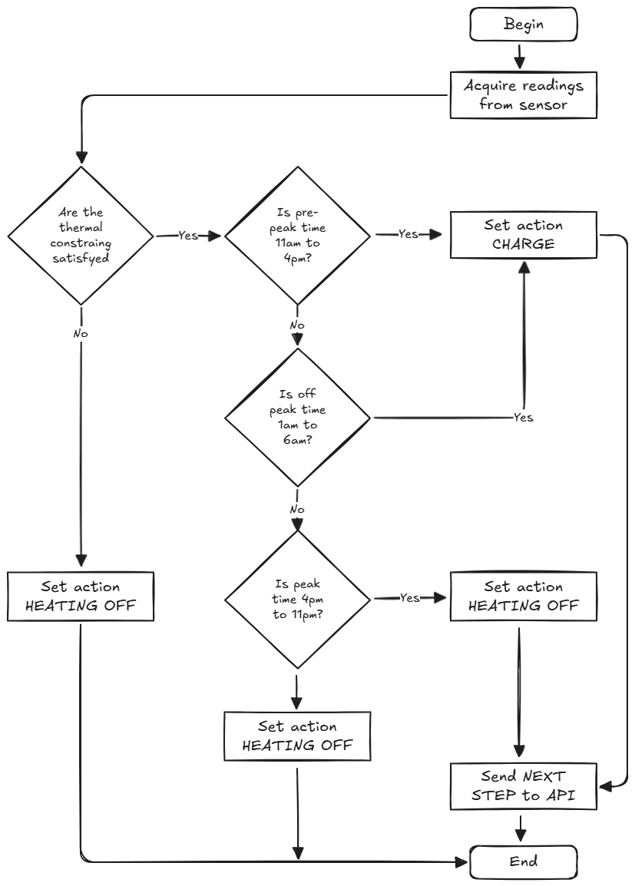
Traditional AI (rule-based AI)
Involves programming explicit rules for the AI system to make decisions.
Rule-based (expert) systems encode experts’ knowledge and skills into a software-based model.
Converts conditions into a series of if/then rules.
No data is needed.

Slide 11
Machine Learning (ML)
A subfield of AI that is focused on getting computers to learn without explicitly programming them and make decisions based on data.
Includes techniques like supervised learning, unsupervised learning, reinforcement learning, and deep learning using neural networks.

Slide 12
FOLLOW ME and see the latest episodes of the 'AI for Business Development' series as they are released. You will learn more about AI and how it can grow your business.
REPOST to help others learn about AI.

